Slide 1

Data Pipeline
Pula Panamgama

Slide 2










Serverless

Slide 3
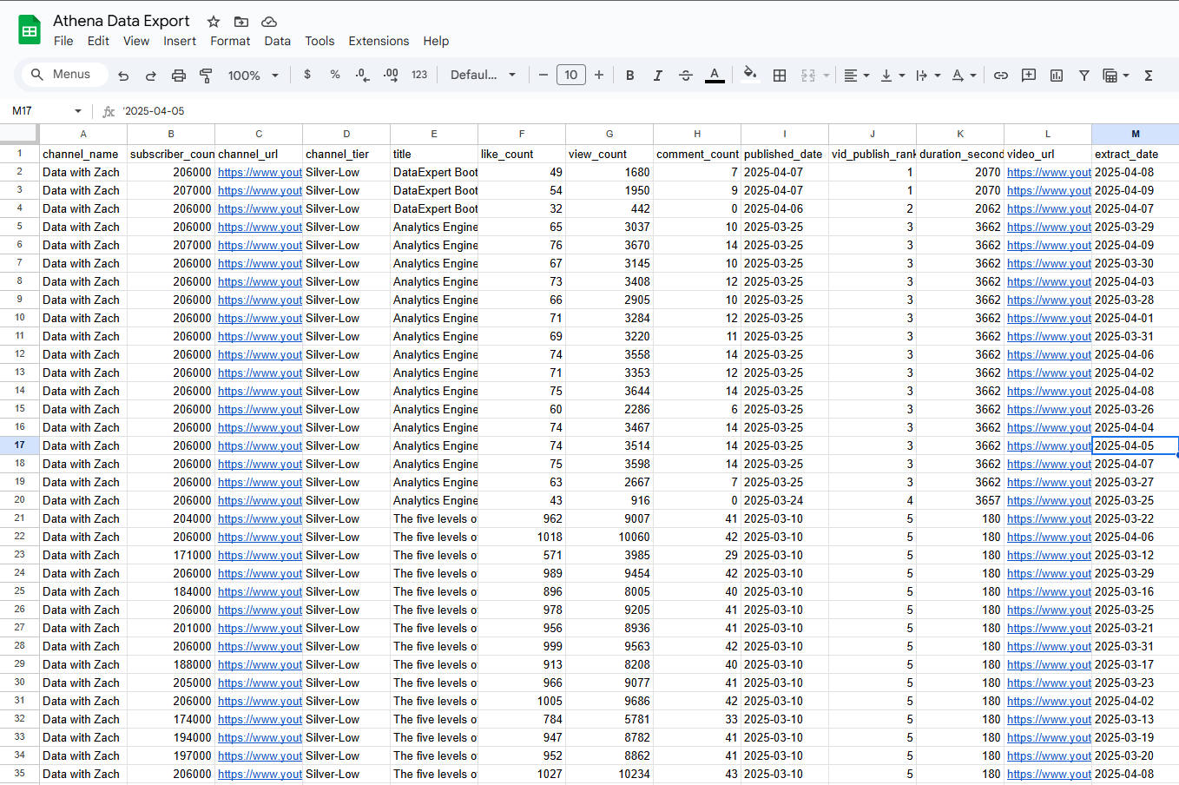
Output
79, 188 rows

Slide 4
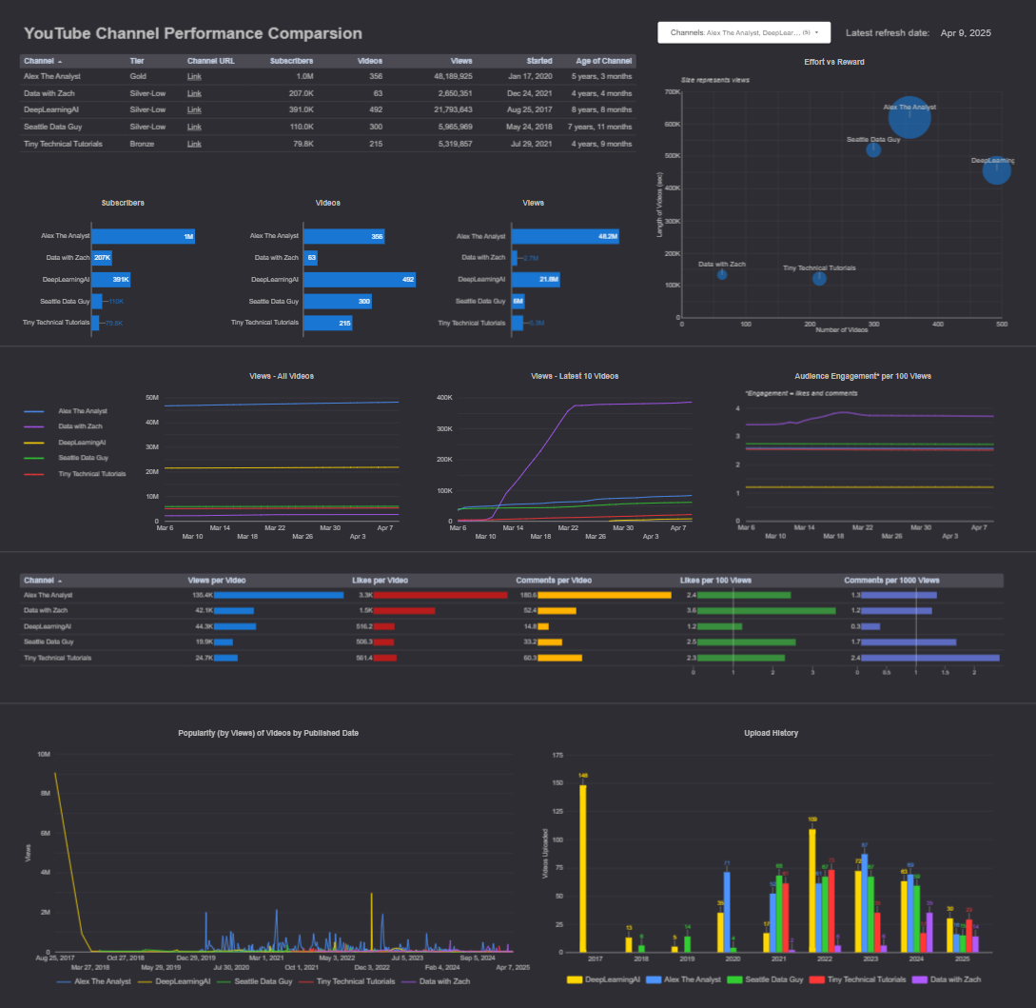
Output
Channel Comparison
Individual Channel Performance (WIP)

Slide 5
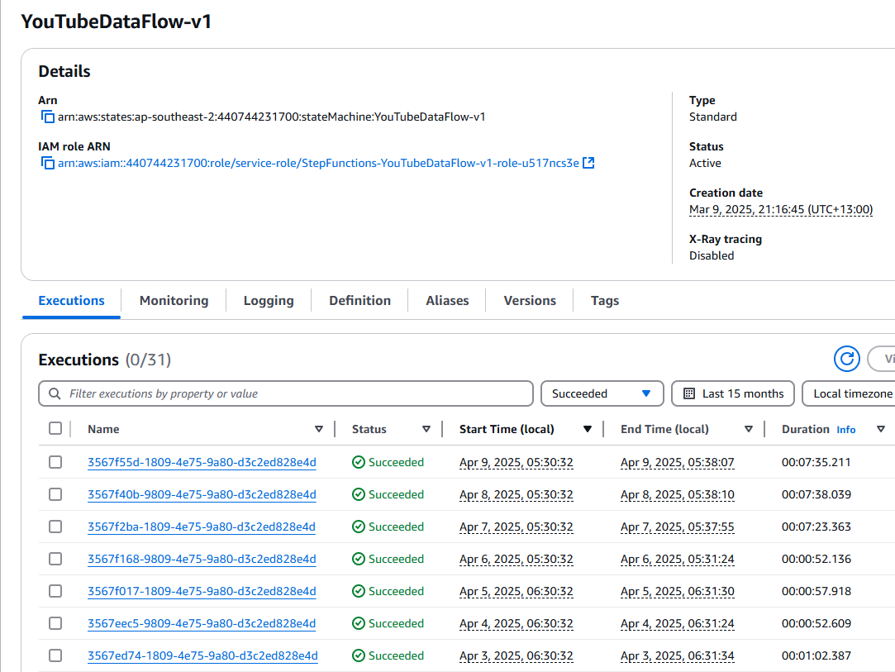
Run Time
32 days +
0 errors
6.30 AM Daily

Slide 6


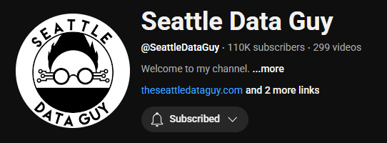




Slide 7
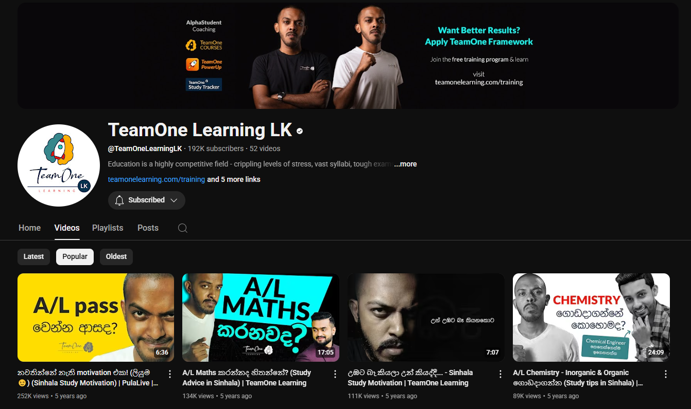

Slide 8


Slide 9
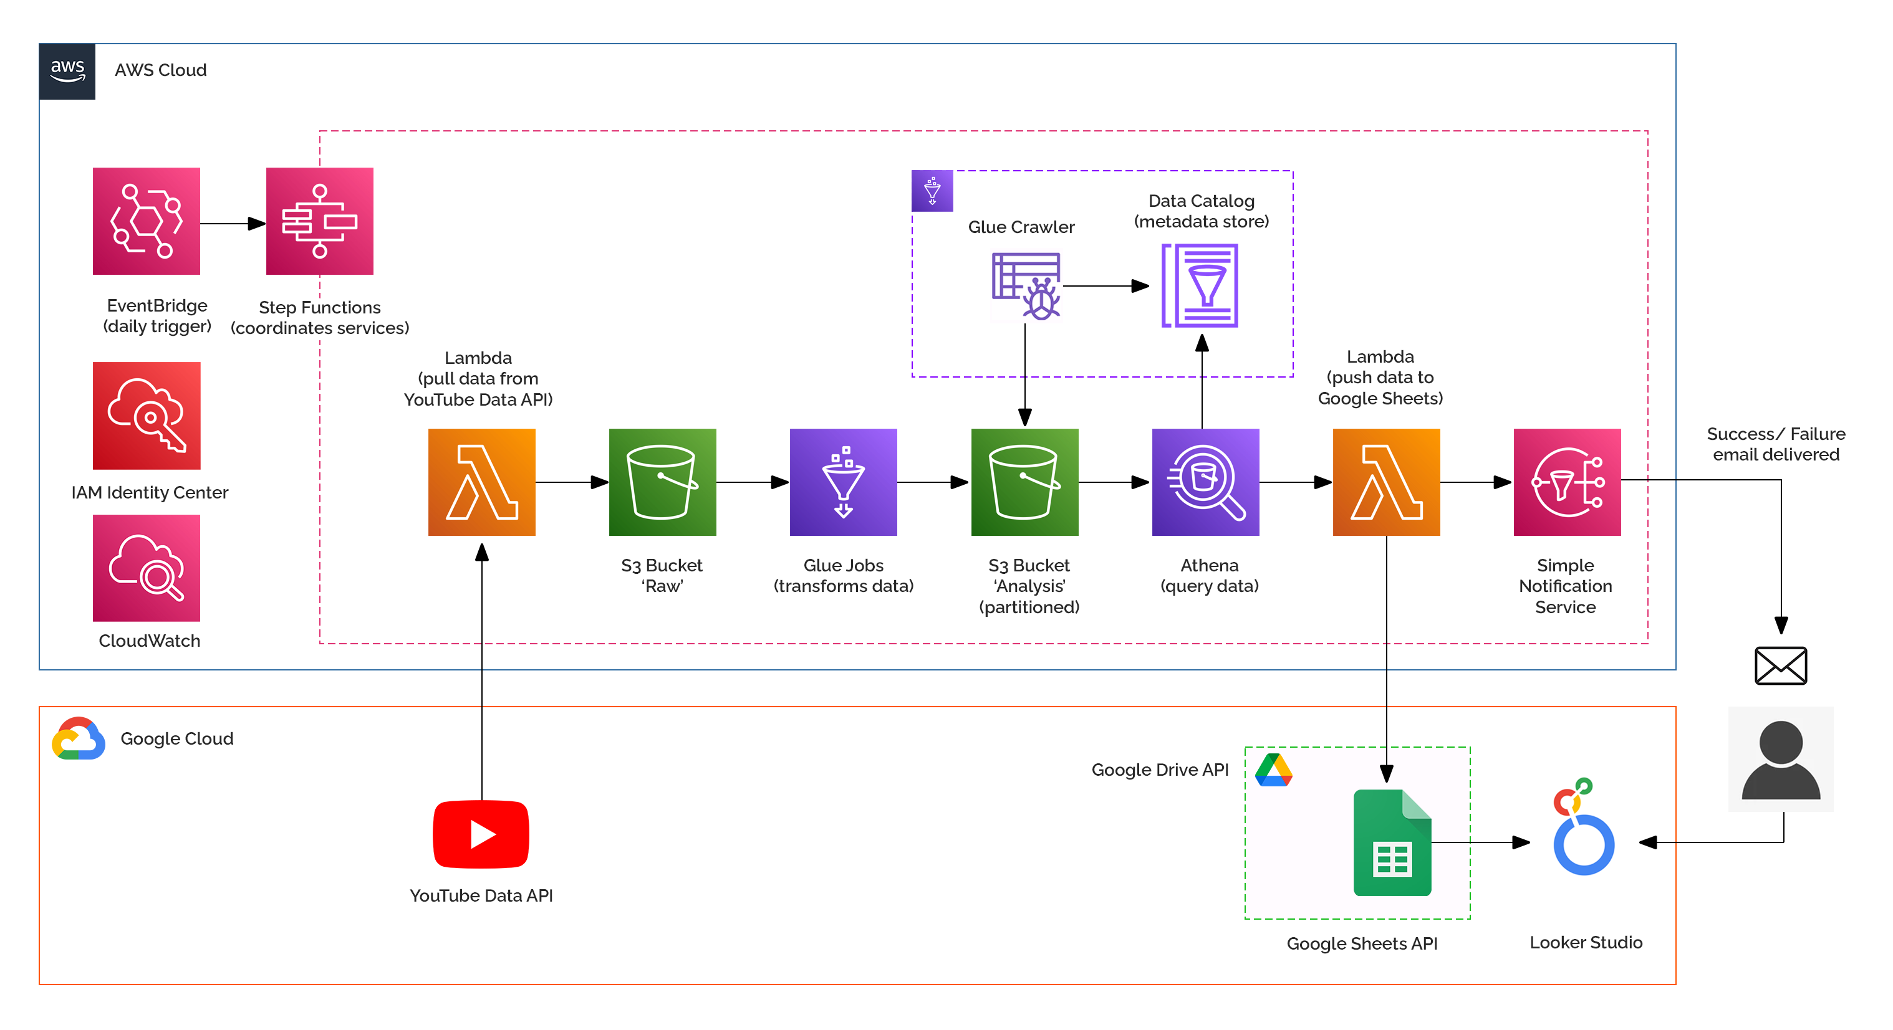

Slide 10
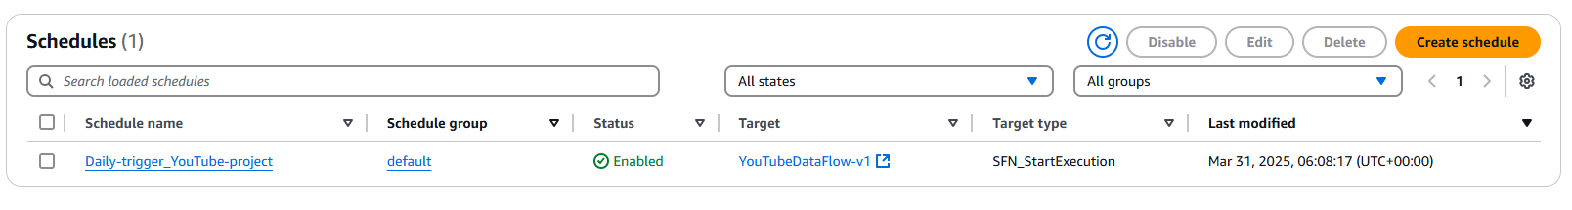
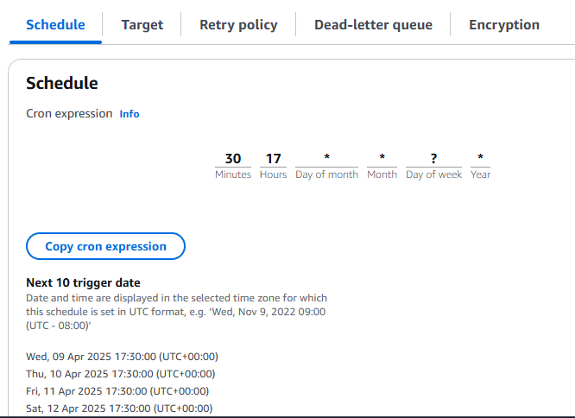
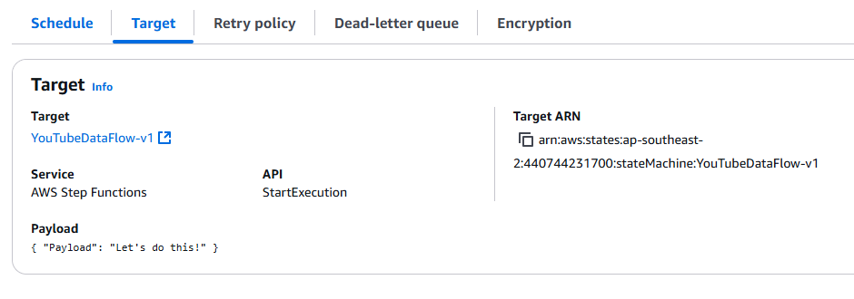
AWS EventBridge
AWS EventBridge is a serverless event bus that routes events from AWS services, apps, or SaaS tools to targets like Lambda or SQS. It helps build event-driven, decoupled systems.

Slide 11
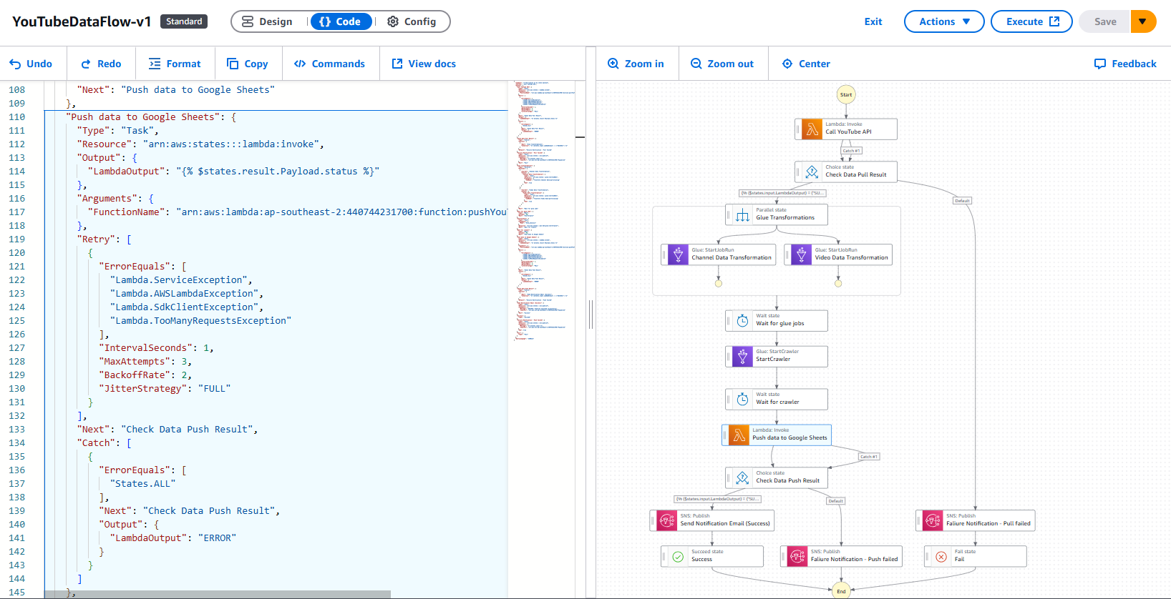
AWS Step Functions
AWS Step Functions is a serverless workflow service that lets you coordinate AWS services using visual workflows. It helps build and run multi-step applications with error handling and retry logic.

Slide 12
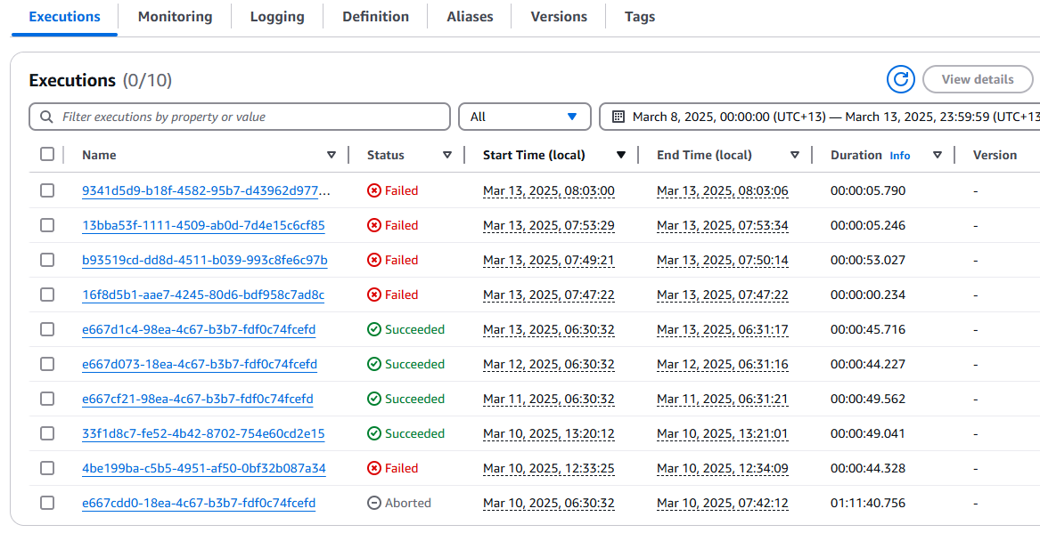

Slide 13
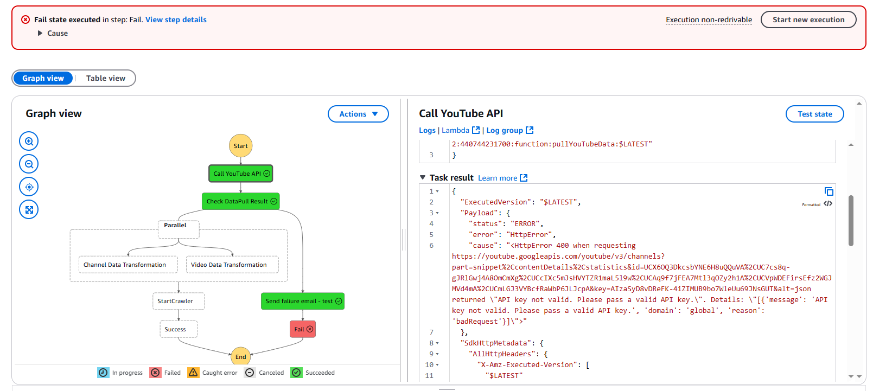

Slide 14
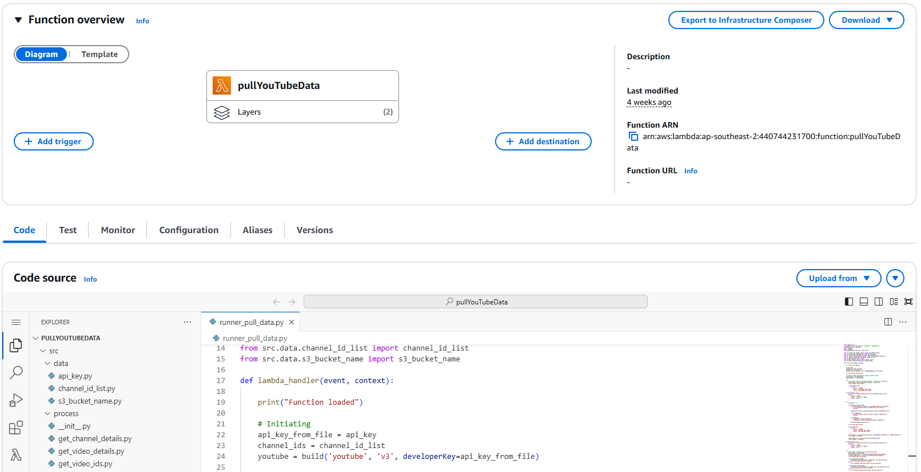
AWS Lambda
AWS Lambda is a serverless compute service that runs code in response to events, automatically managing the infrastructure. It scales automatically and only charges for the compute time used. Execution time is limited to 15 minutes.

Slide 15
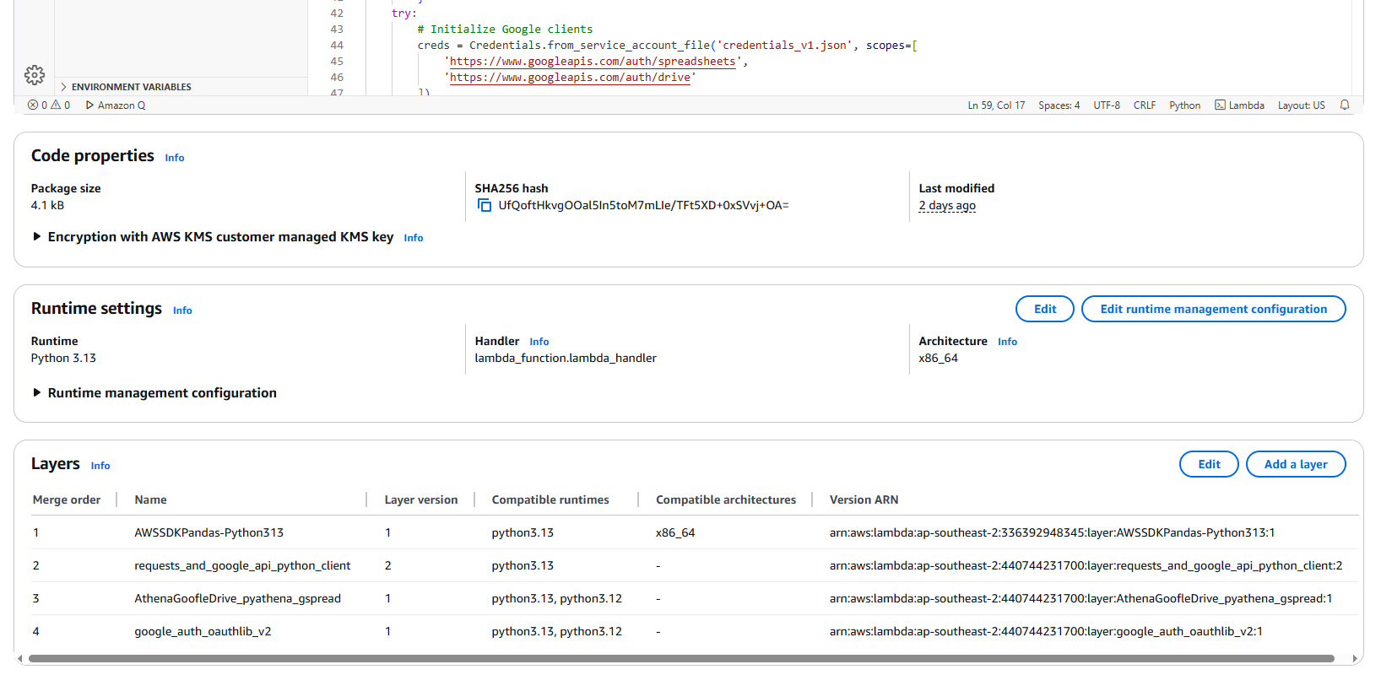

Slide 16
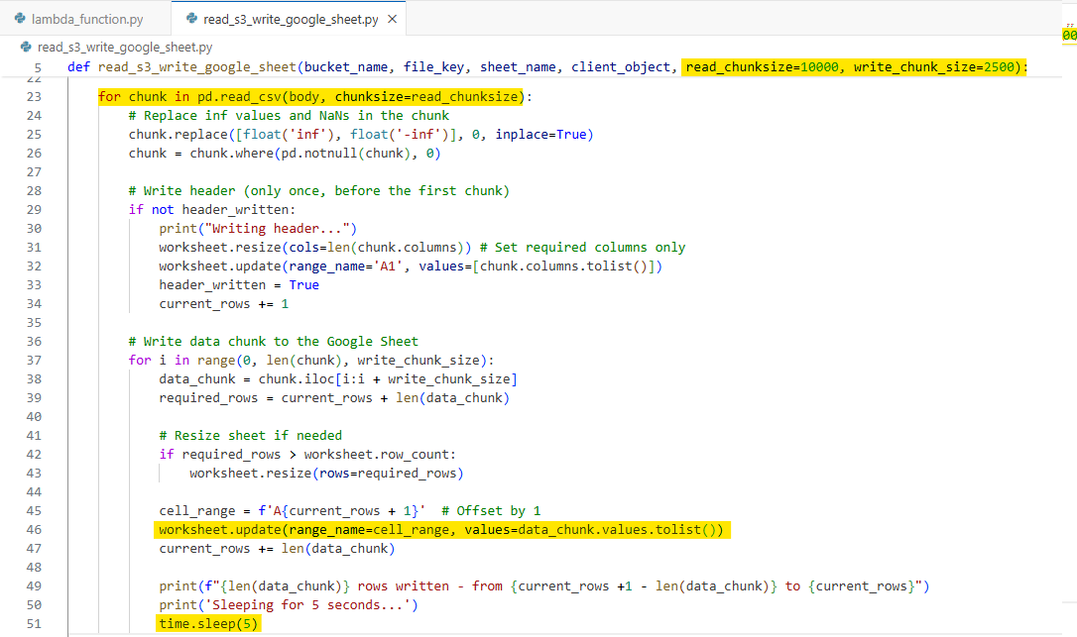

Slide 17
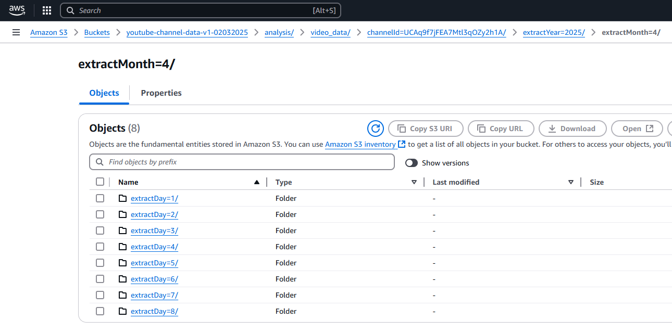
AWS S3 – Simple Storage Service
Amazon S3 is a scalable, serverless object storage service used to store and retrieve any amount of data. Highly available. Has different classes for varied requirements.

Slide 18
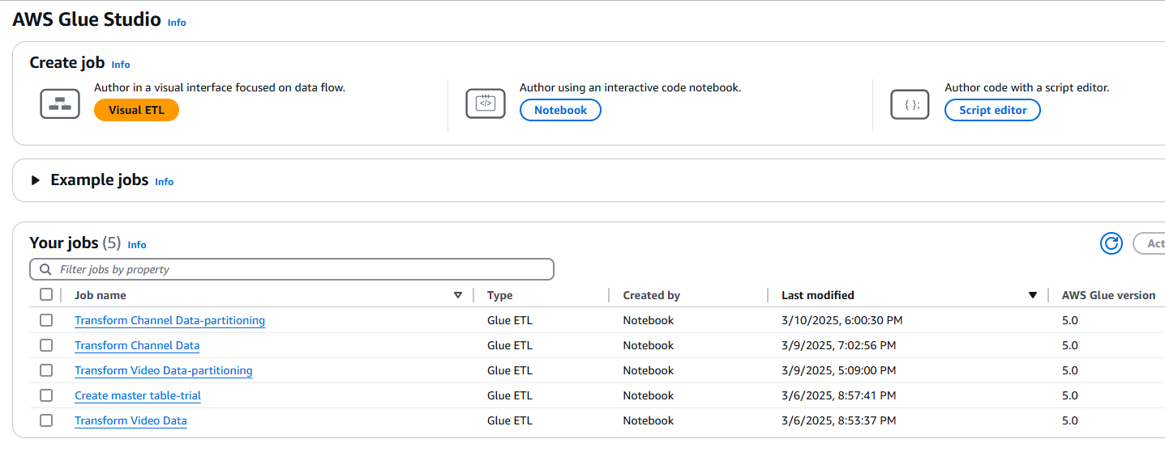
AWS Glue
AWS Glue is a serverless data integration service that helps discover, prepare, and transform data for analytics. It automates ETL processes and supports jobs using Python or Spark.

Slide 19
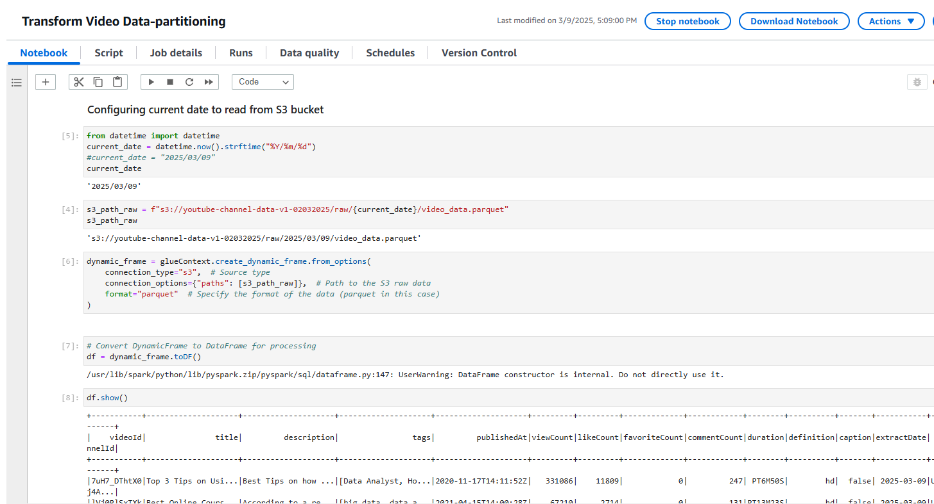

Slide 20
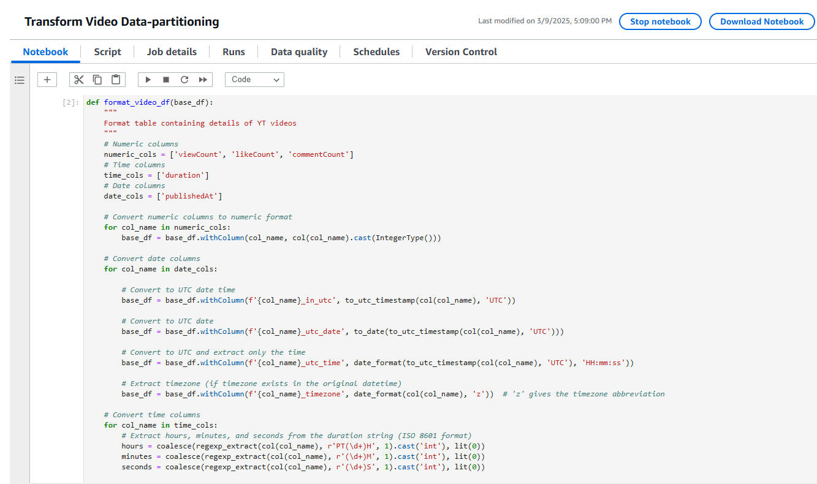

Slide 21
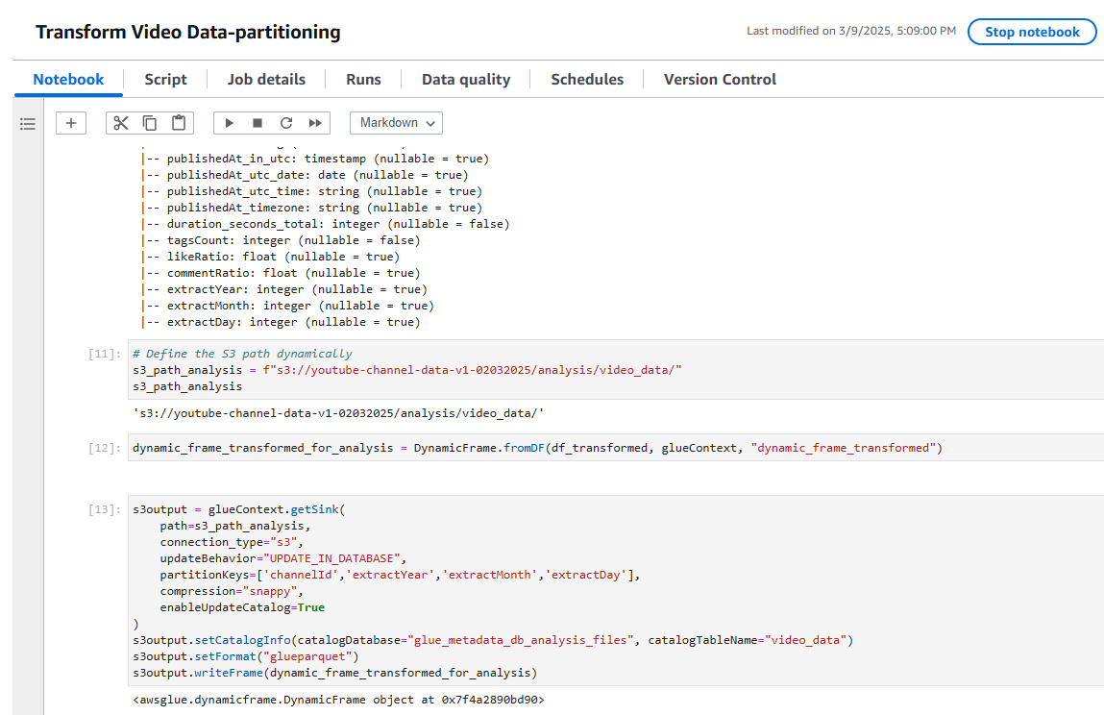

Slide 22
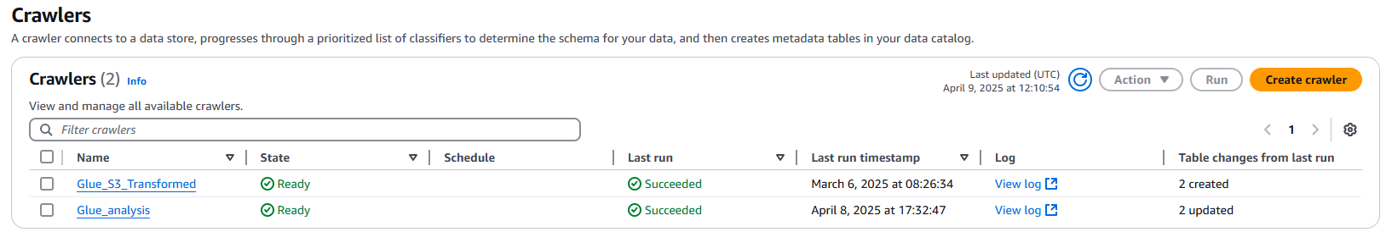
AWS Glue - Crawlers
AWS Glue Crawler is a tool that scans data in sources like S3, infers schema, and creates or updates tables in the Glue Data Catalog. It helps automate data discovery for analytics and ETL.

Slide 23
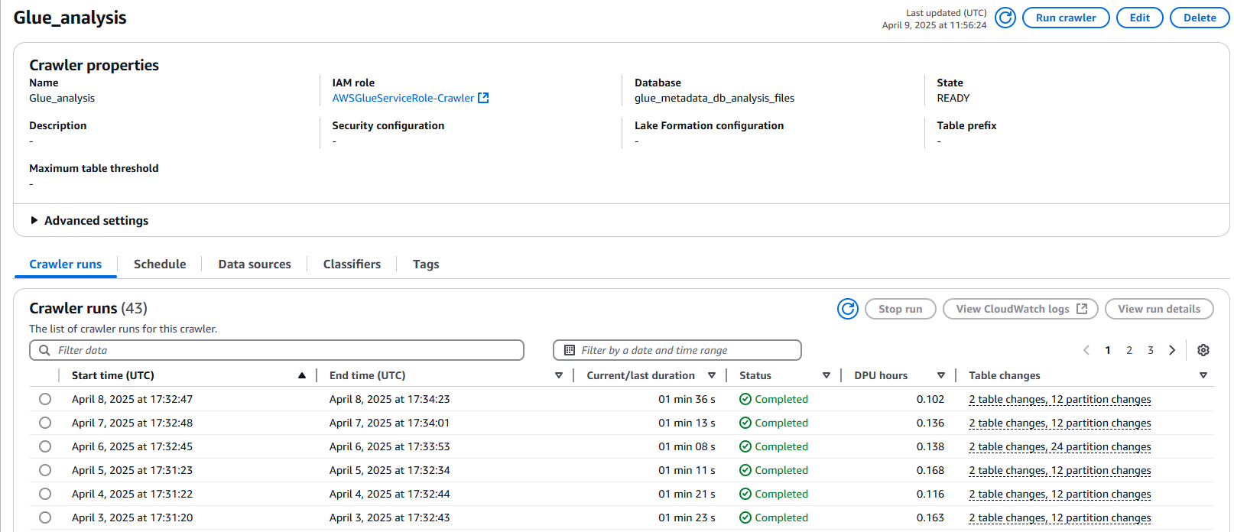

Slide 24
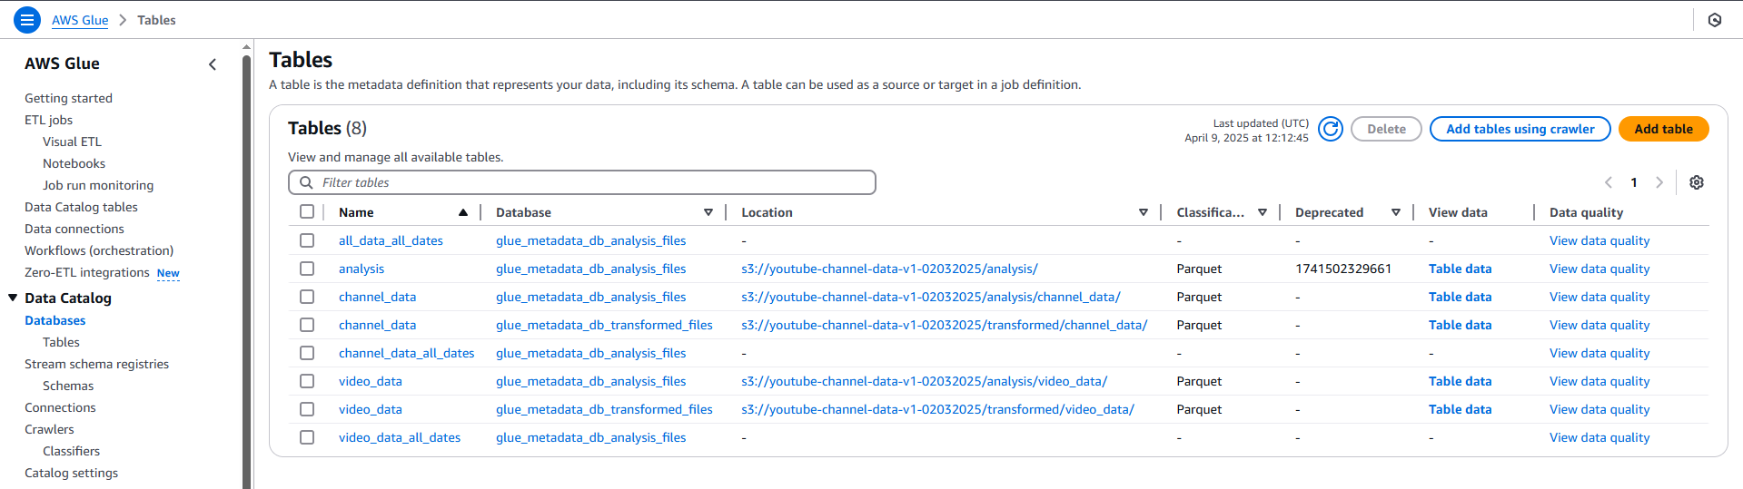
AWS Glue – Data Catalog
AWS Glue Data Catalog is a centralized metadata repository that stores table definitions, schema, and job metadata. It makes data in S3 and other sources easily discoverable and quarriable using tools like Athena or Redshift.

Slide 25
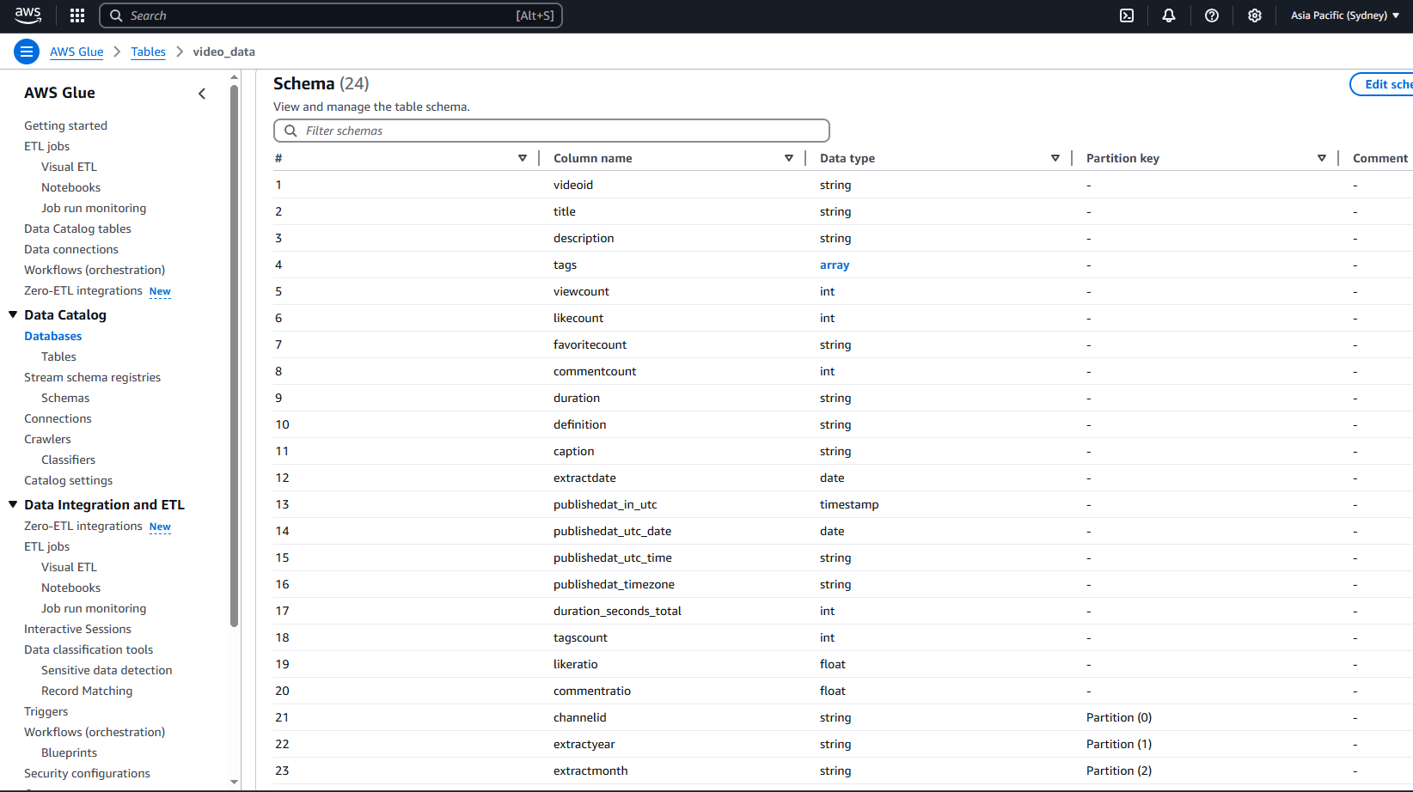

Slide 26
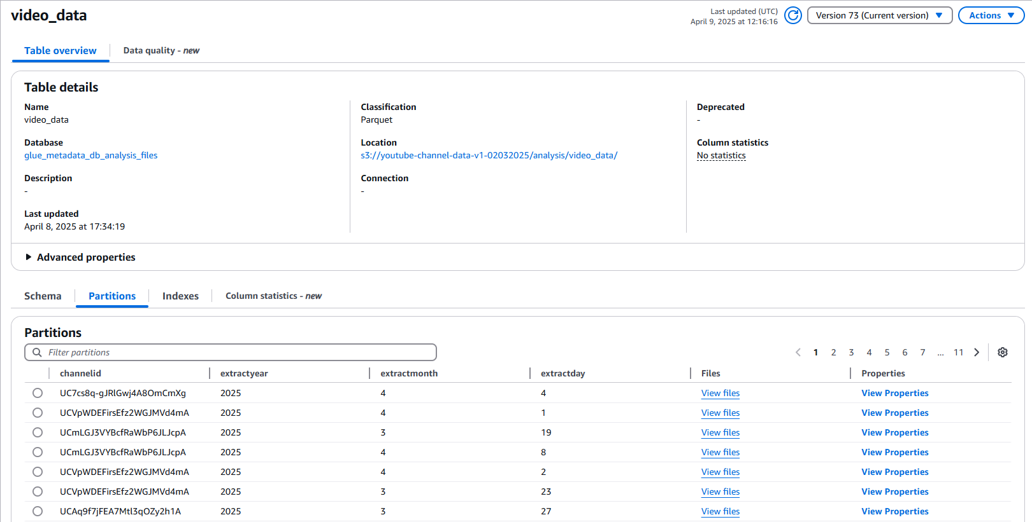

Slide 27
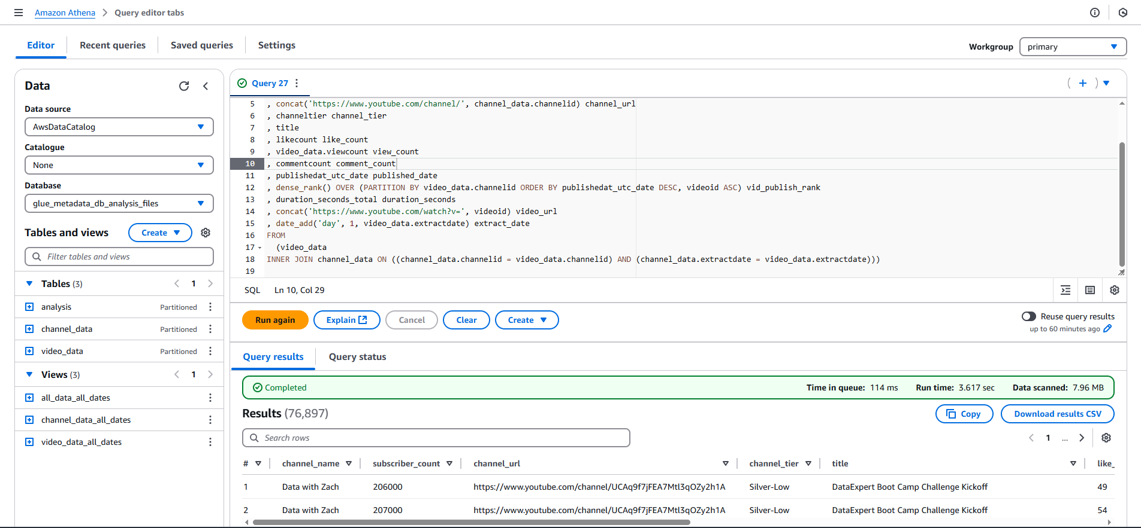
AWS Athena
AWS Athena is a serverless query service that lets you analyze data in S3 using SQL. It uses Glue crawlers to automatically discover and catalog data schemas and AWS Glue Data Catalog to store table metadata to aid in querying.

Slide 28
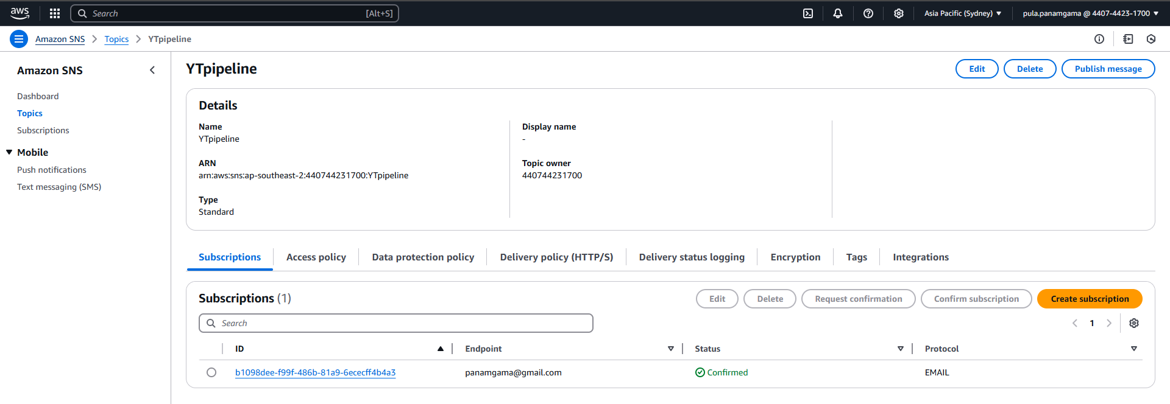
AWS SNS – Simple Notification Service
AWS SNS (Simple Notification Service) is a fully managed service that allows you to send messages or notifications to subscribers via email, SMS, or other endpoints. It helps build scalable, event-driven applications by distributing messages to multiple targets.

Slide 29
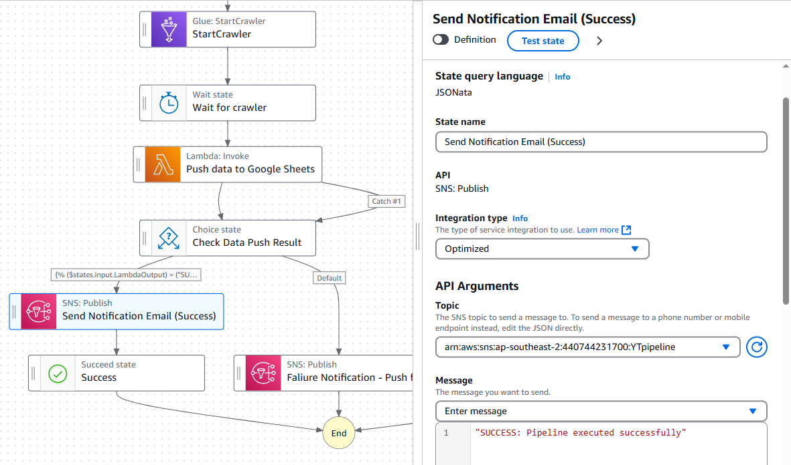

Slide 30
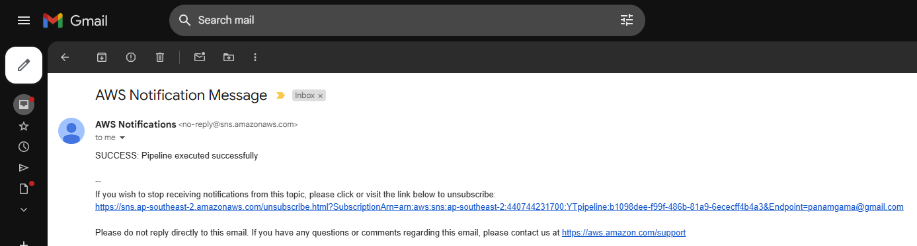

Slide 31
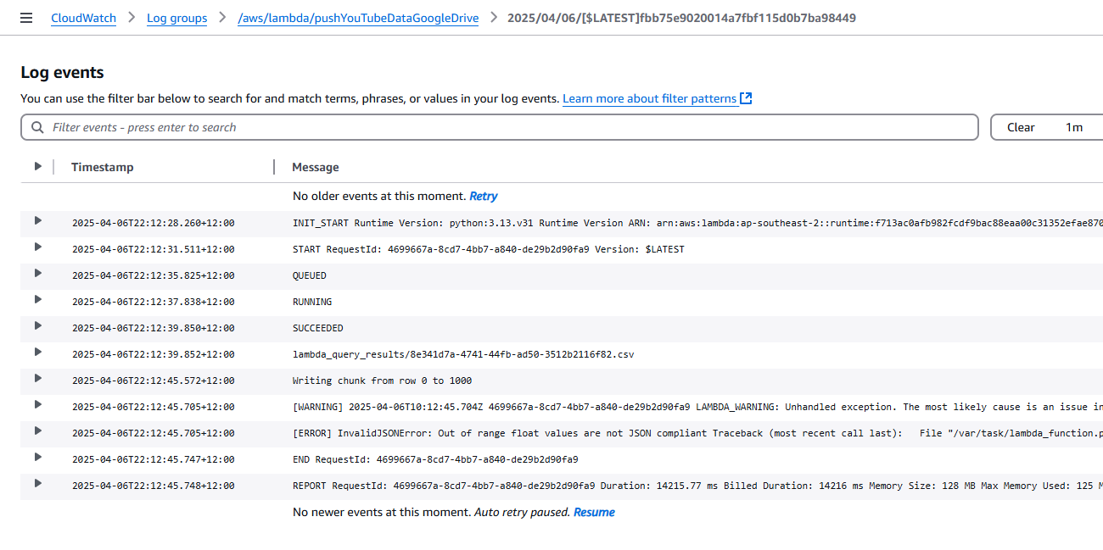
AWS CloudWatch
AWS CloudWatch is a monitoring service that tracks metrics, logs, and events from AWS resources and applications. It helps you gain insights into system performance, set alarms, and automate actions based on defined thresholds.

Slide 32
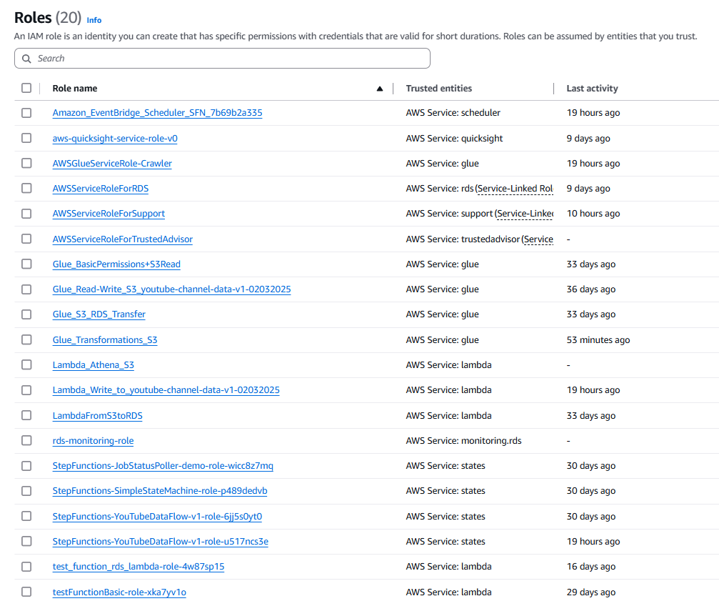
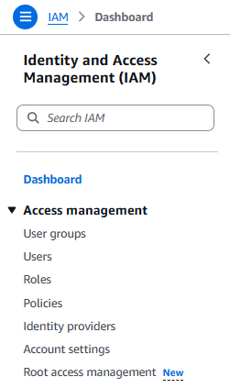
AWS IAM – Identity and Access Management
AWS IAM (Identity and Access Management) enables you to securely manage access to AWS resources. You can create and manage users, groups, and permissions, controlling who can access what in your AWS environment.

Slide 33
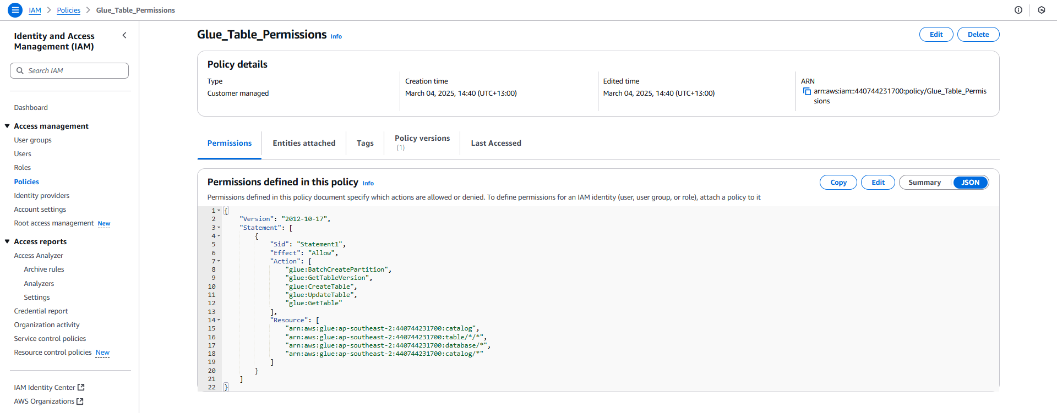

Slide 34

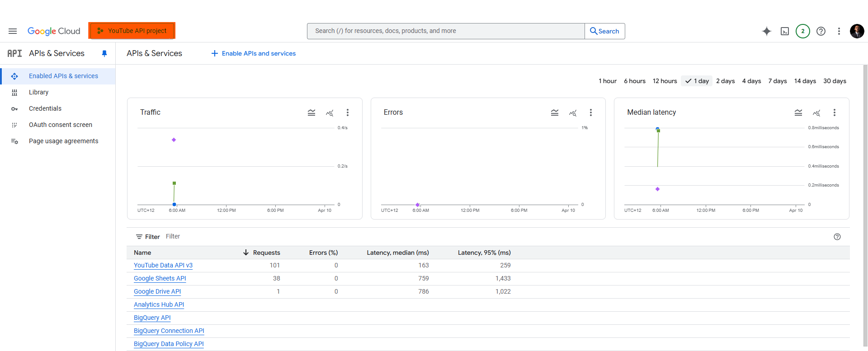
Google Cloud – Free APIs

Slide 35
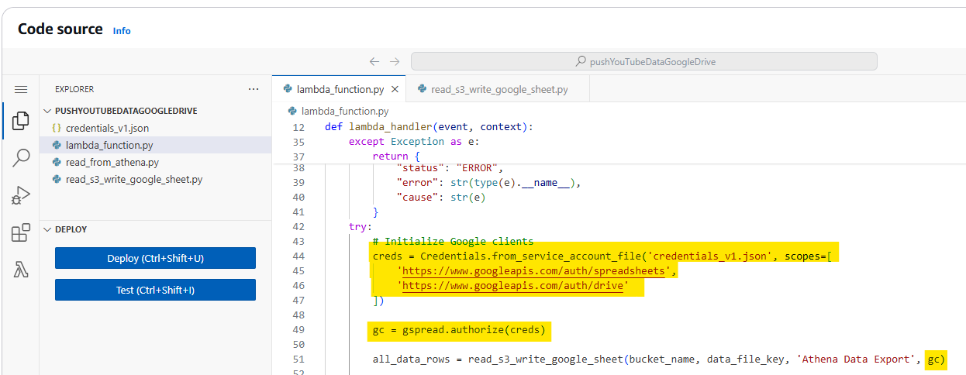
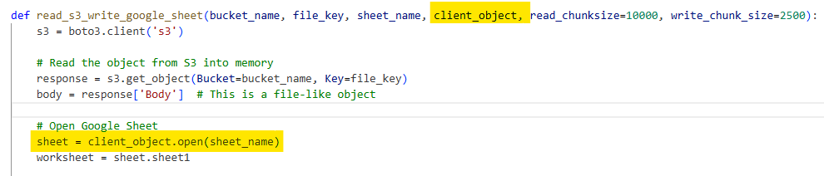

Slide 36
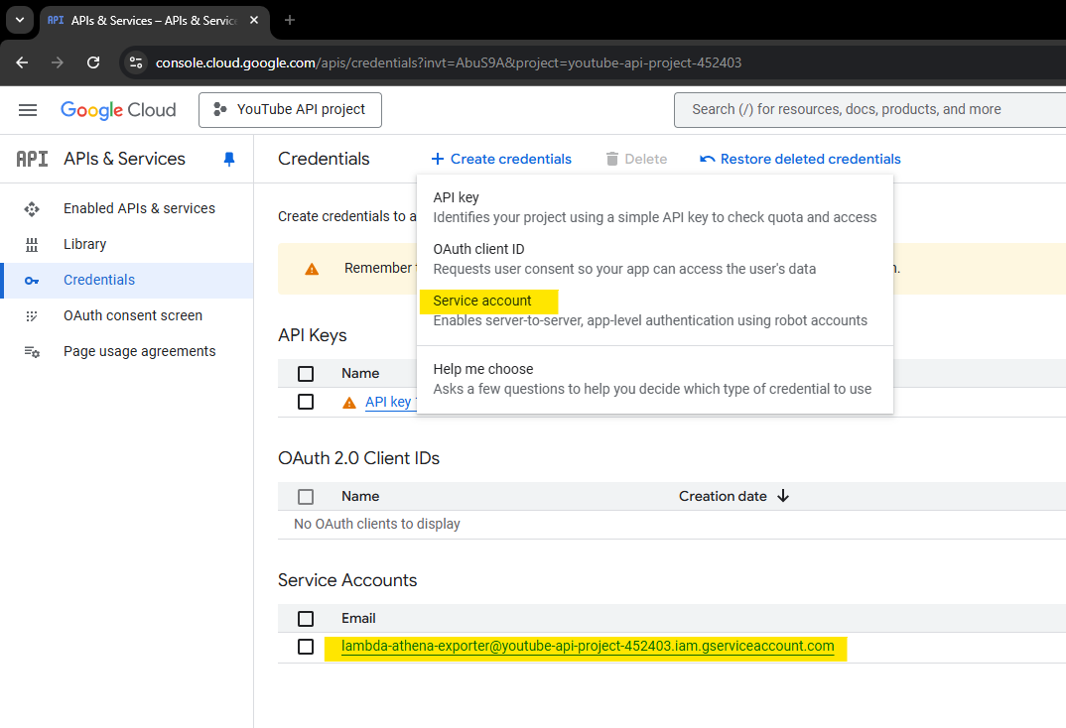
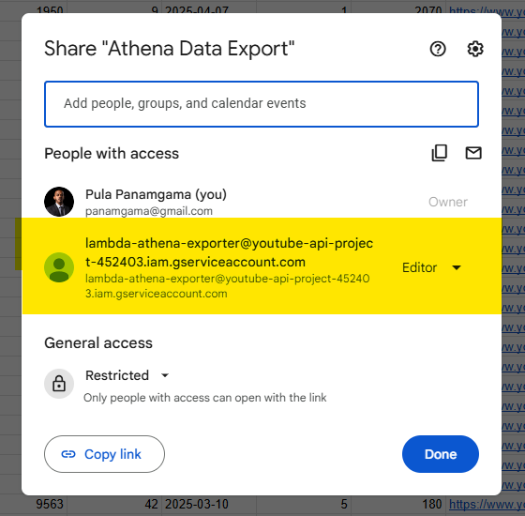

Slide 37
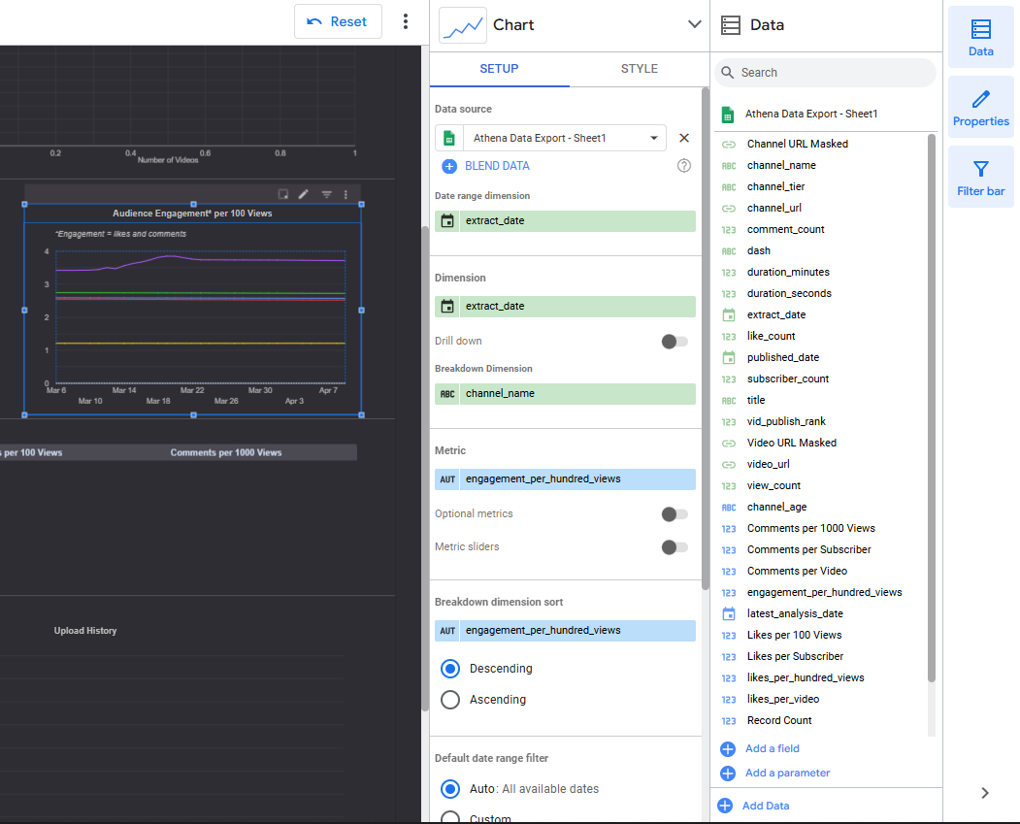
Looker Studio

Slide 38
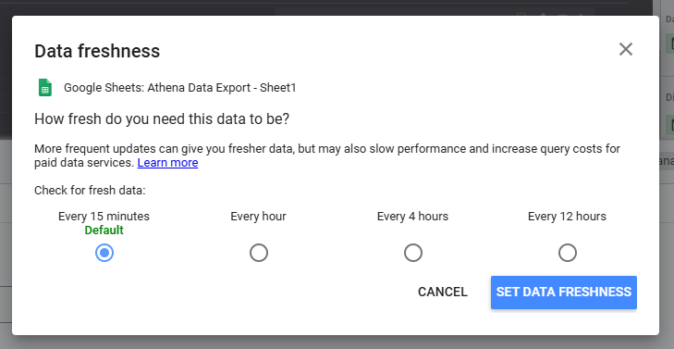
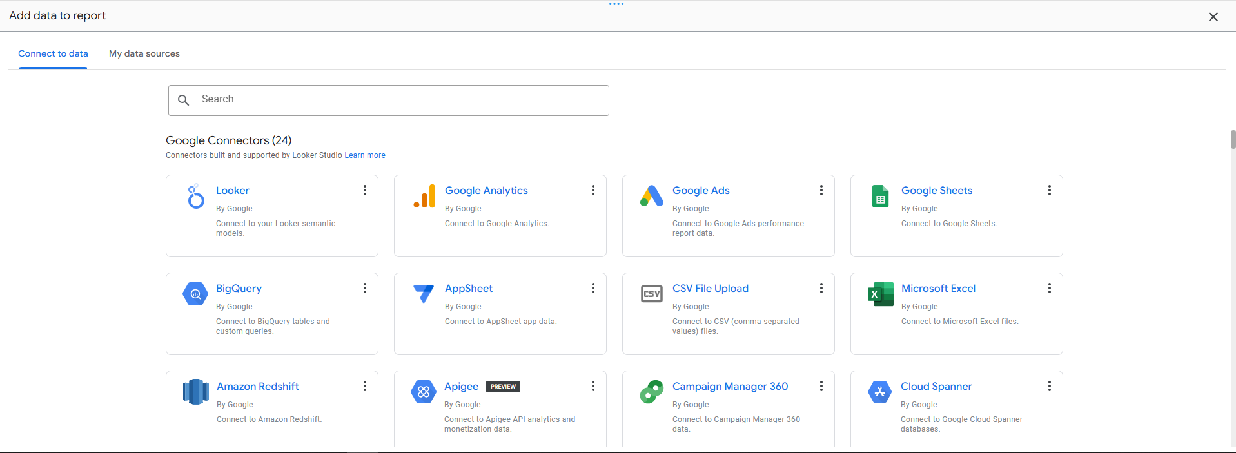

Slide 39

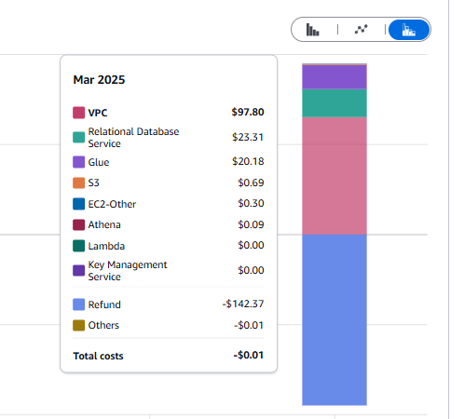
Key Lessons
Keep an eye on the costs - always!
Enable cost alarms and budgets
Not all services are covered by the Free Tier
If it’s a honest mistake, raise a case with AWS support ASAP

Slide 40
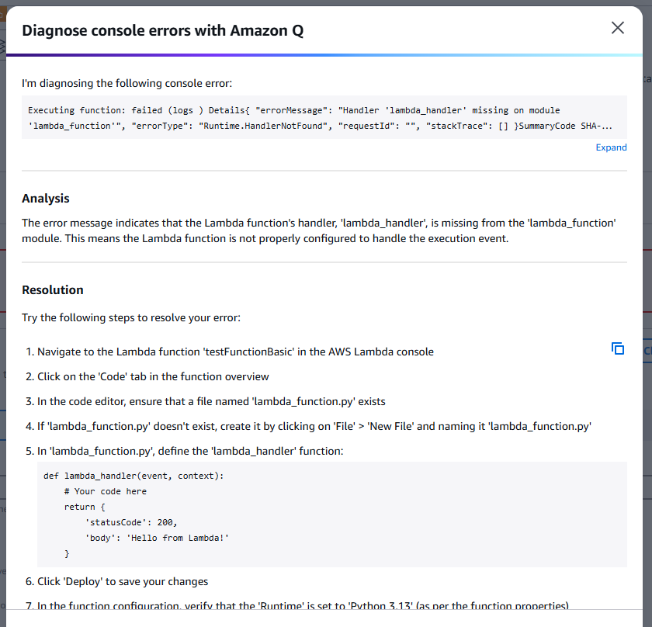
Key Lessons
Check your region when deploying services
Permissions can be a pain
Amazon Q (AI helper) is generally good
It might take time – but NEVER give up!

Slide 41
Thank you!

